Slide 1
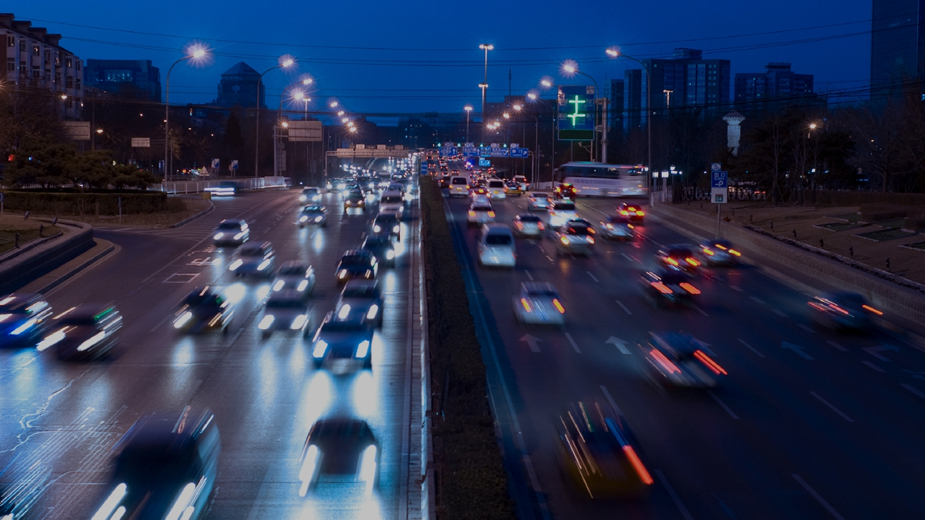

The Future of Wholesale Vehicle Remarketing: The Omni-Channel Experience
Notes:
Good afternoon from my side Ladies and Gentlemen, The Future of Wholesale Remarketing – Omni Channel – so to predict the future of wholesale let me take you on a little retail journey …

Slide 2

Today’s Consumer
Simply put …
Recognize me and
where I am on
my journey
Surface content I want
(or may want) intuitively,
based on intelligent
understanding
Technology
Adoption
Shopping
Convenience
Today’s Consumer
Comprehensive
Information
Make it easy for
me to buy – how and
where I want
Empower me to
share and interact
on any platform
Maintain a consistent
service experience
beyond point of
purchase
Channel –
Agnostic
Thinking
Compelling
Customer
Experience
Notes:
You all are I think aware of the left side of this page-our lifes are getting technologized daily at an ever increasing speed. Key for all of us is the expereince and the convinience of the offer – getting the right offer at the right time at the right price is key… with modern tracking technology it is possible to identify people on their jourey -the same will have to go for wholesales in the future

Slide 3



Path to Purchase
PRE- PURCHASE
WHERE TO START?
40%
Of smartphone users use their device to
FIND or REDEEM COUPONS
SMART
PHONES
AND TABLETS
RETAILER SITE,
STORE, or CATALOG
21%
AMAZON
SEARCH
ENGINE
Of shoppers prefers
Researching and
$1/3$ of all shoppers & $1/2$ of millennials
say their purchases are influenced by SOCIAL MEDIA
11%
2
3
43%
28%
19%
Prefer purchasing
On these devices
Out of
Consumers use smartphones in store
to expand shopping capabilities.
PURCHASE
93%
Of online shoppers take action to qualify for free shipping
85%
are willing to
wait 5 days or
83%
Of shoppers are
Willing to wait an additional
50%
more for delivery, but the majority expect express shipping options
ONLY
53%
have
58%
Have added to cart to qualify
2 days or more to get free shipping
ABANDONED a cart due to LENGTHY DELIVERY TIME
Or no delivery date provided
56%
JUNE
are satisfied with
access to customer service information
during checkout
35%
Have chosen “ship to store” to qualify
Prefer to see the ACTUAL DATE OF ARRIVAL rather than the number of days (5 business days)
3
TUESDAY
POST-PURCHASE
Online shoppers
prefer
36%
HALF of consumers
have purchased additional items from a retailer based on COUPONS or SAMPLES included in the delivery
Are satisfied with Ease of making online returns/ exchanges
47%
are likely to post on social media when satisfied with an online retailer-
$
ONLY
58%
YOU’RE
SUBSCRIBED!
would consider enrolling in the future
1 in 4
Packages delivered to locations other than their home
21%
When dissatisfied
Less than 44% of shoppers are satisfied with flexibility post-shipment in choosing delivery date and rerouting packages
68%
52%
FUTURE STATE:
Say
FREE
Despite recent security issues,
More GAINED trust (18%) than LOST trust (13%) in online shopping last year
Want to see a return label
right in the box
22%
participate in
FREE RETURN
SHIPPING IS KEY
to a positive return experience
“curation services” with personalized box shipments
Notes:
So lets look at the funnel and some key figures that are late developments here … 40% of people search online for Coupons and redeem them – 1/3 of all purchasesrs and more then half of the mellenials say they are influenced by social media… Consumers are willing to wait for free shipping of goods…but 50% abondon a basket if no delivery date or a to lenghty date is indicated… I don‘t want to take you thru all the numbers now – but I guess you get the feeling…

Slide 4
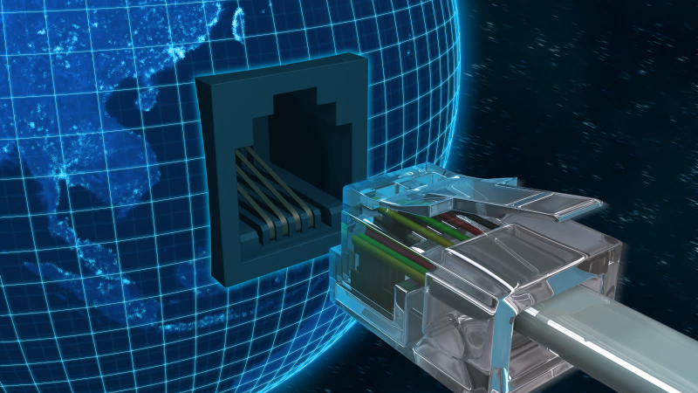
















The Internet Minute in 2017
900,000
Logins
16 Million
Text
Messages
3.5 Million
Search
Queries
4.1 Million
Videos
viewed
70,017
Hours
Watched
342,0000
Apps Downloaded
$751,522
Spent Online
60
SECONDS
46,200
Posts Uploaded
1.8 Million
Snaps
created
452,000
Tweets Sent
15,000
GIFS sent via
Messenger
990,000
Swipes
120
New Accounts
created
156 Million
Emails Sent
50
Voice-First
Devices
Shipped
40,000
Hours
Listened
Notes:
Here an updated slide that might look familiar to you and I will not bother you with numbers you all now or have seen for a while but lets pick out the new ones… Snap Chat …1.8 Mio snaps in one minute…I still haven‘t figured the faszination behind it and trust me i tried… 50 Voice First Devices get shipped per minute… and for what ist worht 990 000 swipes on Tinder are happening…

Slide 5

Simplicity Pays
These disrupters :
61%
64%
of consumers are willing to pay more for simpler experiences
of people are more likely to recommend a brand because it provides simpler experiences
and communications
62%
20%
vs.
of employees are considered brand champions in companies perceived to be simple
of employees are considered brand champions in companies perceived to be complex
$86 Billion
the amount of money brands are leaving on the table when they don’t simplify
Global Brand Simplicity Index 2017
Notes:
Simplification is a key – according to the Global Brand Simplicity Index 64 % of consumers are willing to pay for simplicity – they even put a number on this and recon 86 Billion are left on the table by companies being to complicated…

Slide 6
From Selling Products to Delivering Solutions
and Services
What does it take to deliver truly simple experiences ?
emerging brands that are changing the stakes share what it takes to deliver simple, meaningful customer experiences
These disrupters :
1
Empower people
Sidestep traditional industry protocols and shift power to consumers
2
Reimagine experiences
Turn underwhelming experiences into moments of delight
Global disrupters
3
Remove friction
Identify pain points in everyday processes, and remove them
4
Save time
Value people’s time by providing service where and when they need it most
5
Provide utility
They demonstrate usefulness beyond their core offerings or services
Global Brand Simplicity Index 2017
Notes:
SO how do you od this …. Its 5 key things you need to keep at heart… Empower People … (Steve Jobs..) Reimagine over and over again…. Remove Friction … boundaries are here to be broken down … time is money…always has been always will be…. Provide utility….well go the extra mile …

Slide 7
Current State

Slide 8
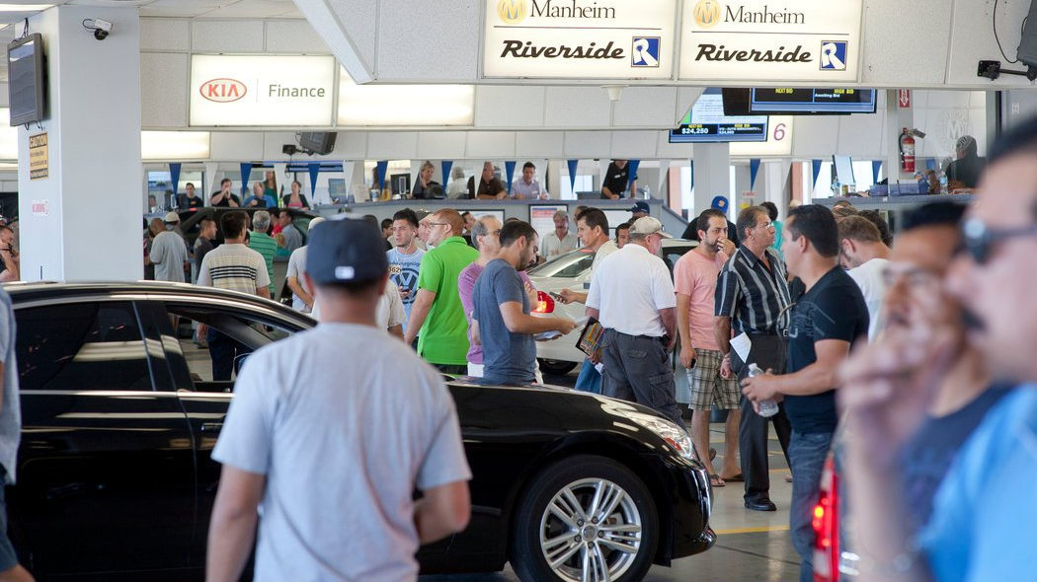
Auto Remarketing Overview Today’s Process
Notes:
On this slide I leave it up to each of you how to put the numbers and identify for yourself where you start your process today… but I am quiet sure most of you use multiple channels along the way that are not necissarily connected or ideally interlinked…

Slide 9
The Future

Slide 10
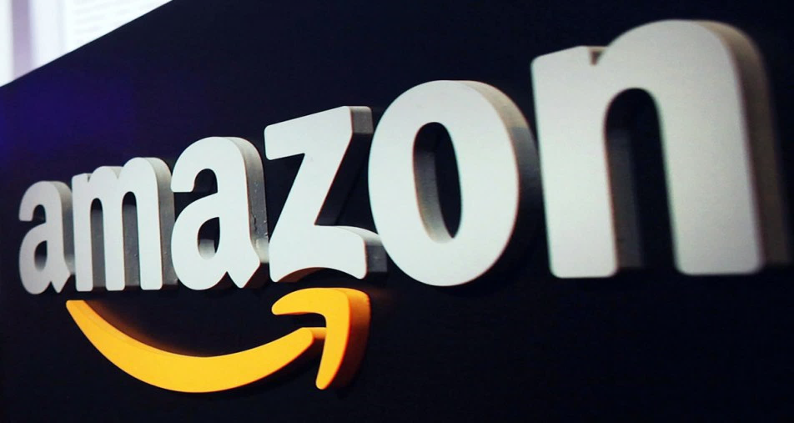
Deliver an end-user experience from single to multiple touchpoints in sync with needs and preferences
FROM SINGLE TO OMNI-CHANNEL
Single-channel commerce
Multi-channel commerce
Cross-channel commerce
Omni-channel commerce
Yesterday
Today
Tomorrow
Future winners
Notes:
So what is happening in the retail from the old Single channel commerce we are now moving into an omnichannel world – well I guess I have a short example for you… holiday and new bed…

Slide 11



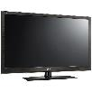






Marketplace
Customers see one brand and multiple touch-points operating together
Retailers coordinate and operate in a differentiated manner across channels
In-store kiosks
Smart-phones
TV/adverts
Seamless
delivery across all channels
Web
Pick-up points
Stores
Events/pop-ups
Social
A marketplace allows for more opportunities for buyers and sellers to connect and transact how they want and when they want.
Notes:
Ultimatly all your offering needs to be around your clients at any time in multiple channels…

Slide 12
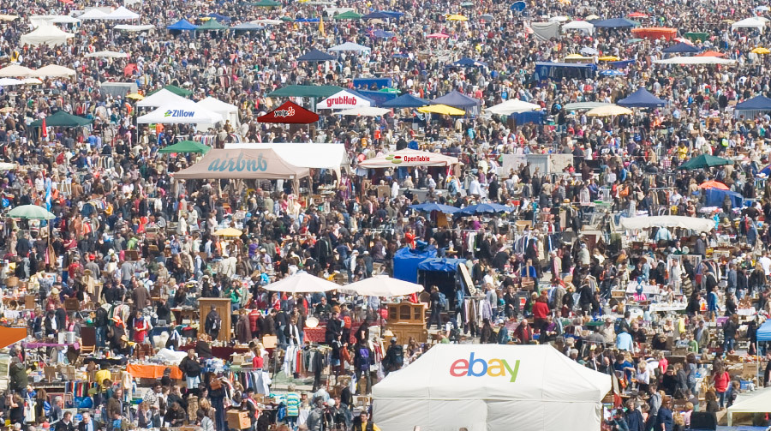
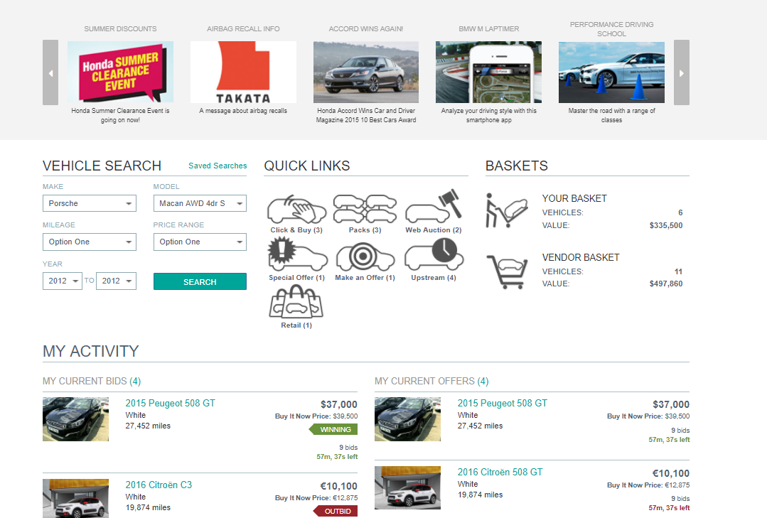
Transcript into the Remarketing World
Notes:
SO you might want to think of a market place that allows for various products at the same time all at hand… using information on your clients to publish relevant offers….

Slide 13









The Extraordinary Size of Amazon
Amazon is bigger than most brick and mortar retailers put together
Market Value as of December 30,2016
$355.9B
$297.8B
Amazon
http://www.visualcapitalist.com
Notes:
If you do not believe me it can happen … look at what Amazon has done to the Retail industry and where we there market capitalization is…

Slide 14
No matter what people tell you, words & ideas can change the world!
-
Robin Williams
Notes:
Thank you for your attention and let me close with a short statement by one of the worlds greatest actors and I can tell you tha tI have tried this myself a couple of times and it is true… if you want to change the future of the wholesale remarketing … talk about if, creat ideas and make them happen!

