Slide 1
Dealership Process to Maximize Opportunity.
Notes:
9 slide presentation to introduce the DrivingSales brand, the problem we solve for our market and our solution.

Slide 2
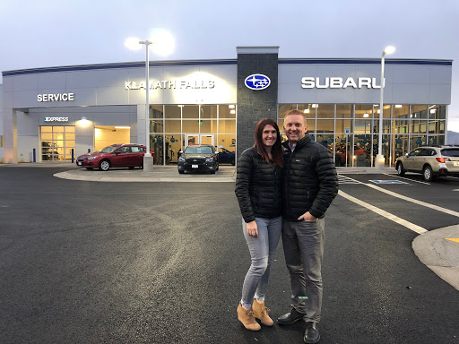
Jared & Kristi
Hamilton

Slide 3
What is Strategy?
Reed Wilcox

Slide 4
Strategy = Allocation of Assets
Reed Wilcox

Slide 5
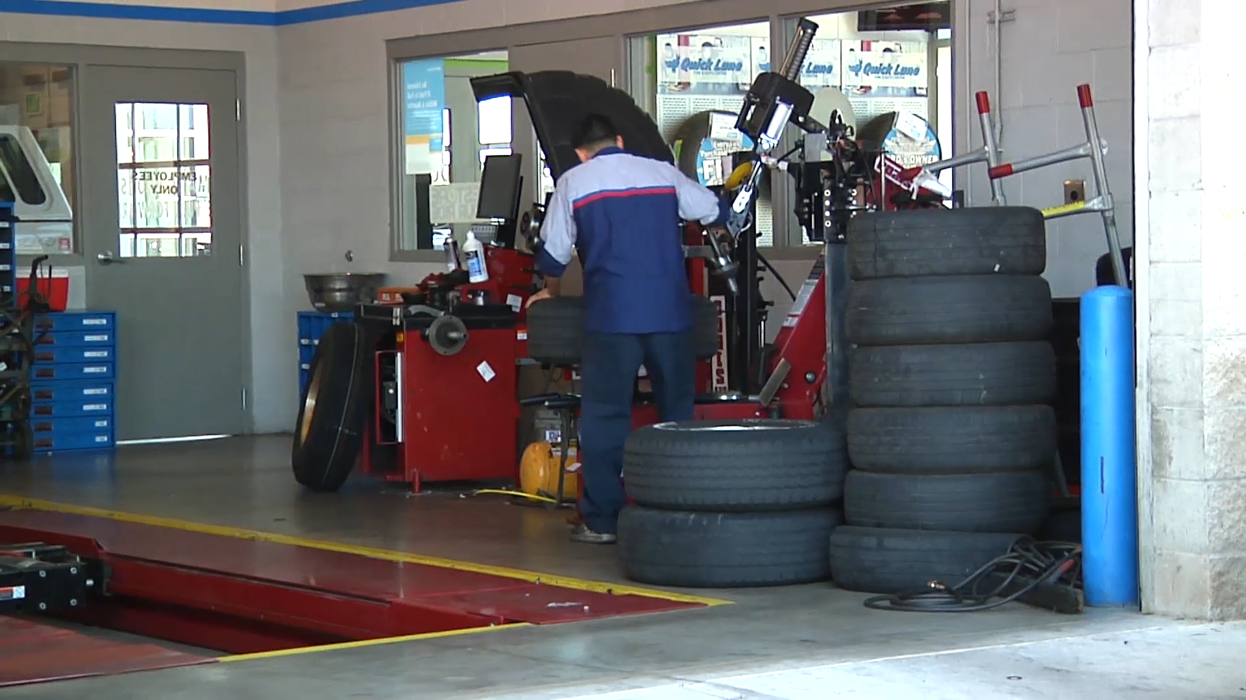
What assets do dealers need to optimize?
What assets do we manage as dealers?

Slide 6
Assets to Optimize
Inventory Assets
Multiplier Assets
Used Inv | New Inv. | Parts | Tech Time | Brand | Customers | Capital | People
Days Supply Price to Mkt Turn Rate Gross | Days Supply Price to Mkt Turn Rate Gross | Days Supply Obsolescence Turn Rate Gross Margin | Proficiency Efficiency Productivity | Market-Consideration Reputation CSI | Traffic Be back Total closing Repeat Shop retention | CIT Receivables Leverage WIP | Progression Productivity Activity Competency Turnover
Acquisition Recon Merchandise Pricing Promoting Turning | Acquisition Merchandise Pricing Promoting | Stocking Return policy | Inspections Walk around Upsell Parts Dist. | Messaging Social SEO Paid Mkting | Phone Walk in Lead Equity | Funding Stips Receivables | Competency Mapping Development Performance Reviews
Asset
Asset
Asset
Asset
Asset
Asset
Asset
Asset
Metric
Metric
Metric
Metric
Metric
Metric
Metric
Metric
Process
Process
Process
Process
Process
Process
Process
Process

Slide 7
Asset Stewardship
 | Brand | Cust. | People | Capital | New | Used | *Brand | *Cust.
Sales
Team Lead
Finance
New Car
Used Car
GSM
GM
X
X
X
X
X
X
X
X
X
X
X
X
X
X
X
X
X
X
X
X
X
X
X
X
X
X
X
X
X
X
X
X
X
X
X
Notes:
Asset optimization is standardized across org chart.
Each employee is a steward.

Slide 8
Process:
Meetings
Notes:
9 slide presentation to introduce the DrivingSales brand, the problem we solve for our market and our solution.

Slide 9
Dealership Meeting/Ops Objectives
Asset focus: What assets are we optimizing?
Metric review: Is the asset healthy?
Process review: How to increase the performance of the asset.
Define & share written tasks, execute
Notes:
How to have asset optimization focus: every meeting, interactions the same
Example: used car manager

Slide 10
Process:
Sales/Customer Experience
Notes:
9 slide presentation to introduce the DrivingSales brand, the problem we solve for our market and our solution.

Slide 11
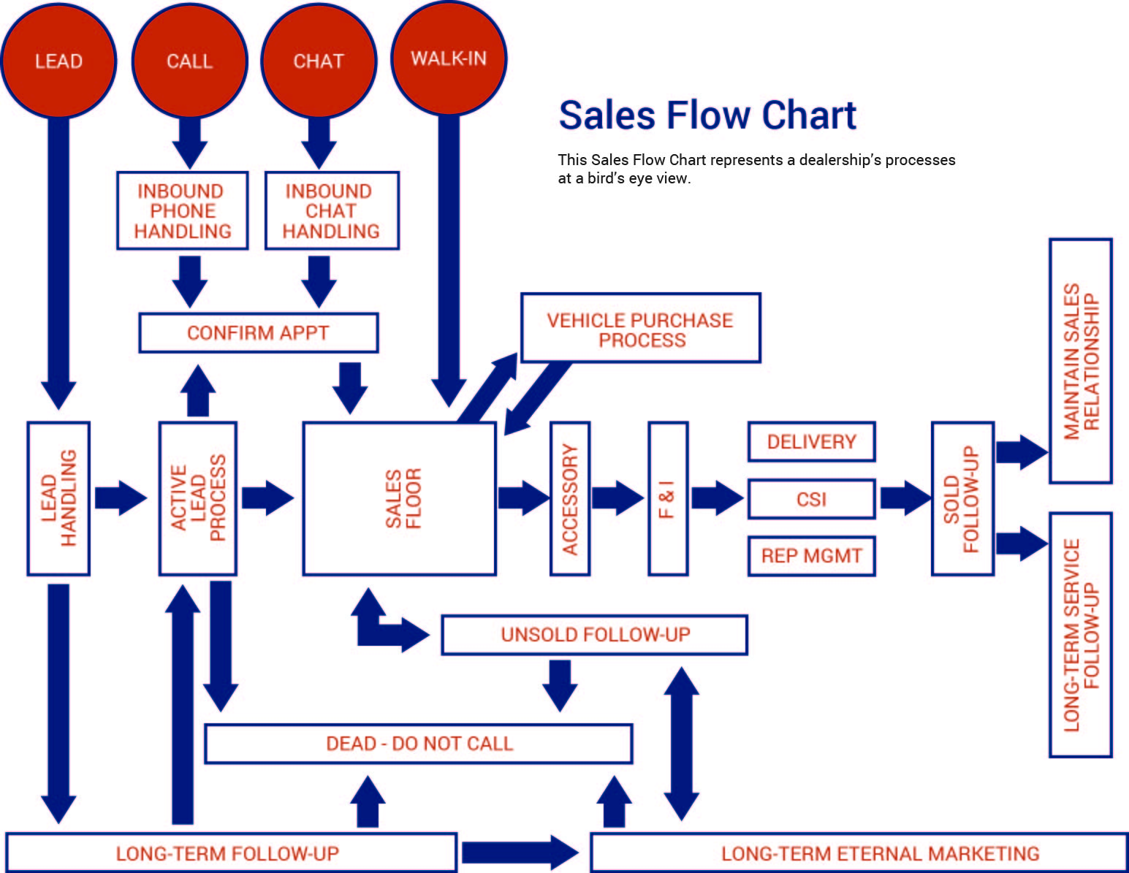
v
v
v
v
v
v
v
v
v
v
v
v

Slide 12
Process:
New/Used Inventory
Notes:
9 slide presentation to introduce the DrivingSales brand, the problem we solve for our market and our solution.

Slide 13
Stock
Recon/Prep
Merchandise
Turn
Notes:
9 slide presentation to introduce the DrivingSales brand, the problem we solve for our market and our solution.

Slide 14
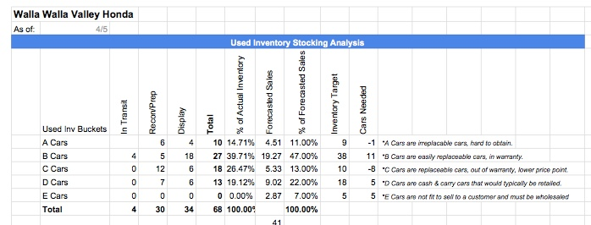
Do we have inventory to make our forecast?
What should our days supply be?
What will be the impact be of current inventory on gross?
What cars do we need to purchase?
Do we have any recon issues?

Slide 15
Do we have any problem inventory that we need to handle?
Is each bucket priced according to our pricing strategy?
What cars need to be repriced due to aging?
What cars need to be highlighted in the sales meeting for aggressive pricing?

Slide 16
Used Car Management Schedule
Monday:
Line lot
Inspect Merchandising
Compile Reports
Drive Inventory
Inspect Recon
Buy Replacements
Tuesday (off):
Inspect Recon
Inspect Merchandising
Buy Replacements
Wholesale aged cars
Wednesday:
Inspect Recon
Inspect Merchandising
Buy Replacements
Wholesale aged cars
Thursday:
Reprice Report
Hang tags
Dot Cars
Define Spiffs
Buy Replacements
Friday:
Launch Spiffs
Announce Repricings!
Line Lot
Close wholesales
Appraise & Sell!
Saturday:
Appraise & Sell!

Slide 17
Process:
Human Capital Management
Notes:
9 slide presentation to introduce the DrivingSales brand, the problem we solve for our market and our solution.

Slide 18
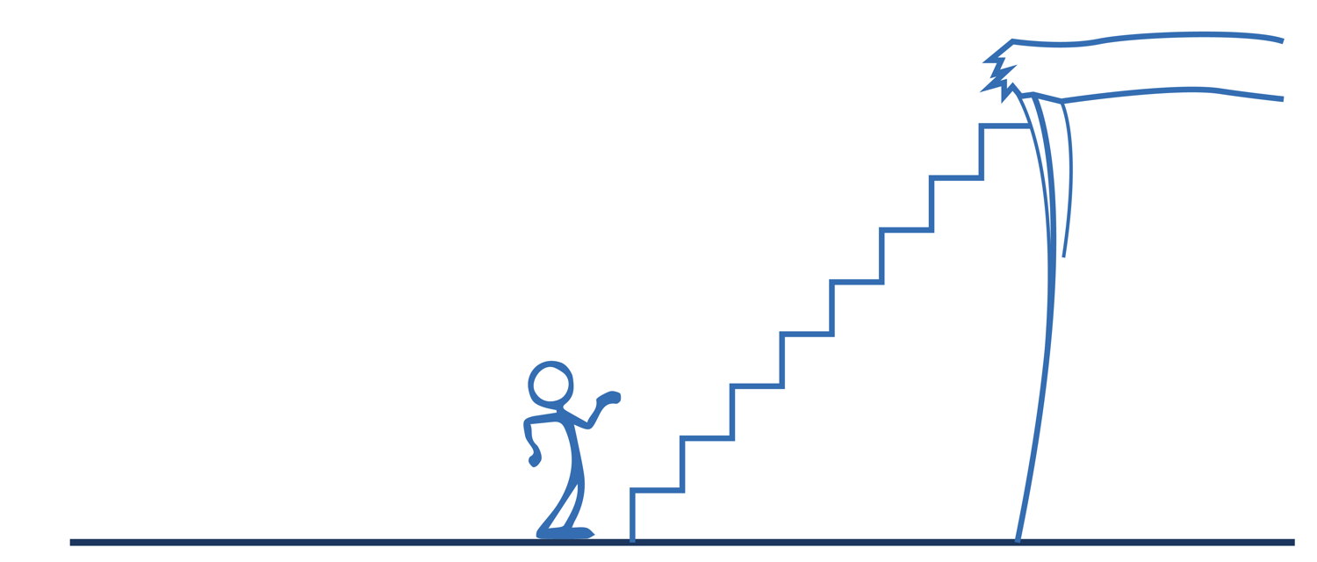
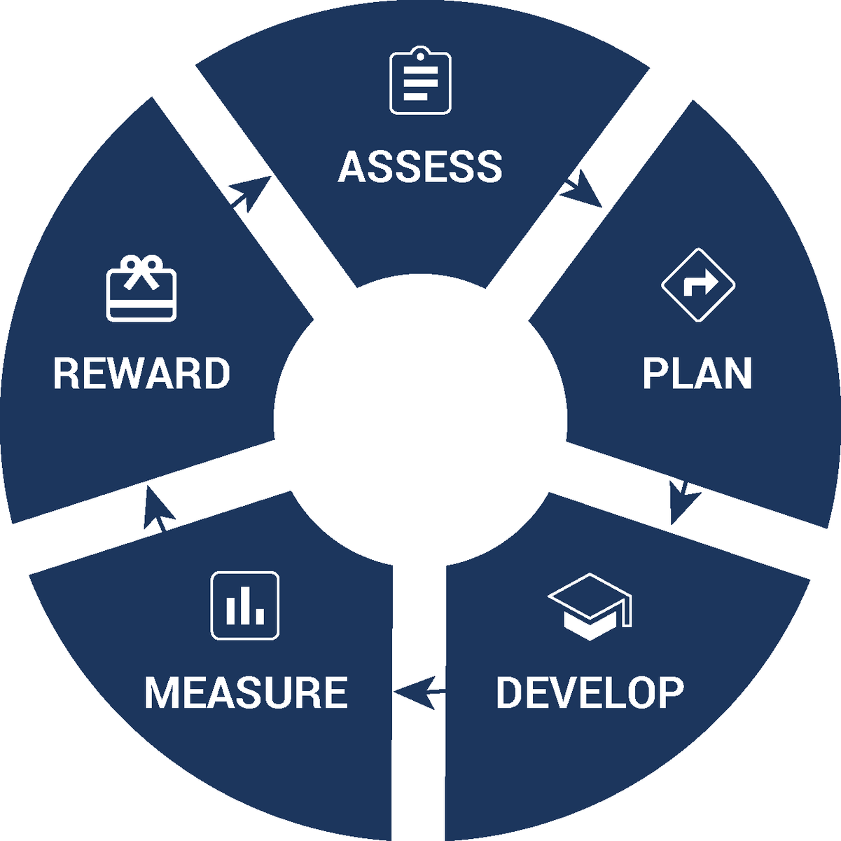
High Performance
HCM Process
A structured process to advance employees’ careers while optimizing their performance.
Growth Requirements
Growth
Standards:
Development Requirements
Habits to Build
Achievement Requirements
Sr. Sales
Consultant
Sales
Consultant
Jr Sales
Consultant
Trainee

Slide 19
What have we learned from the aggregation of industry data?
Notes:
Lets look across the industry and see where we can improve.
Start by looking at Return on Assets.
Not ROI: No leverage, No turn
Sales looks good, but its not.

Slide 20
$27,791
For every $10,000 what is returned? (ROA)
$25,714
$6,667
$1,384
$638

Slide 21
For every $10,000 what is returned? (ROA)
$36,361
$27,971
-$24,726
Notes:
This compares 10k ivested in each type of employee
Severe drop off because they burn opportunities, lower closing rate.
Vegs higher closing, higher gross due to UA on trades

Slide 22
“Millennials don’t want to work hard enough to be successful.”
“We hire from the same talent pool you do.”
-Disney Institute

Slide 23
High Performance
HCM Process
A structured process to advance employees’ careers while optimizing their performance.
Growth Requirements
Growth
Standards:
Development Requirements
Habits to Build
Achievement Requirements
Sr. Sales
Consultant
Sales
Consultant
Jr Sales
Consultant
Trainee

Slide 24
Asset
Process
Metrics
Notes:
9 slide presentation to introduce the DrivingSales brand, the problem we solve for our market and our solution.

Slide 25
1. Asset + Process = Success Metric 2. Optimize People for Biggest Impact 3. Process Optimizes People
Conclusion:

Slide 26
Thank You
Jared @DrivingSales.com
Notes:
9 slide presentation to introduce the DrivingSales brand, the problem we solve for our market and our solution.

