Slide 1
European disruption within the Automotive sector
Notes:
Thank you for inviting me to this fantastic event. I will like to talk about some of the trends in the European Automotive market and look into why market changes so slowly.

Slide 2
Morten Holmsten Global Director, Autorola Marketplace
Notes:
My name is Morten Holmsten and I’m working as Global Director for Autorola Marketplace. As you can hear, this presentation is going to be in English as my Turkish is not existing. But I have some of my colleagues with me today, so if you have any questions, you are welcome to meet us at the booth later today.

Slide 3
Morten Holmsten Global Sales Director
Morten Holmsten Global Sales Director
Notes:
As I said, I’m in charge of one of Autorola’s 3 business units. The 3 business units are Solutions, where we primarily works with customized workflow systems to support everything from Intake of vehicles to the total remarketing process. All of this can be managed and measured towards agreed KPI’s.
Indicata is our market intelligence tool, which based on realtime data measures the performance of your inventory towards the total market.
The last of our Business Units is Marketplace, where we arrange online vehicle auctions either national or internationally depending of the market conditions.

Slide 4
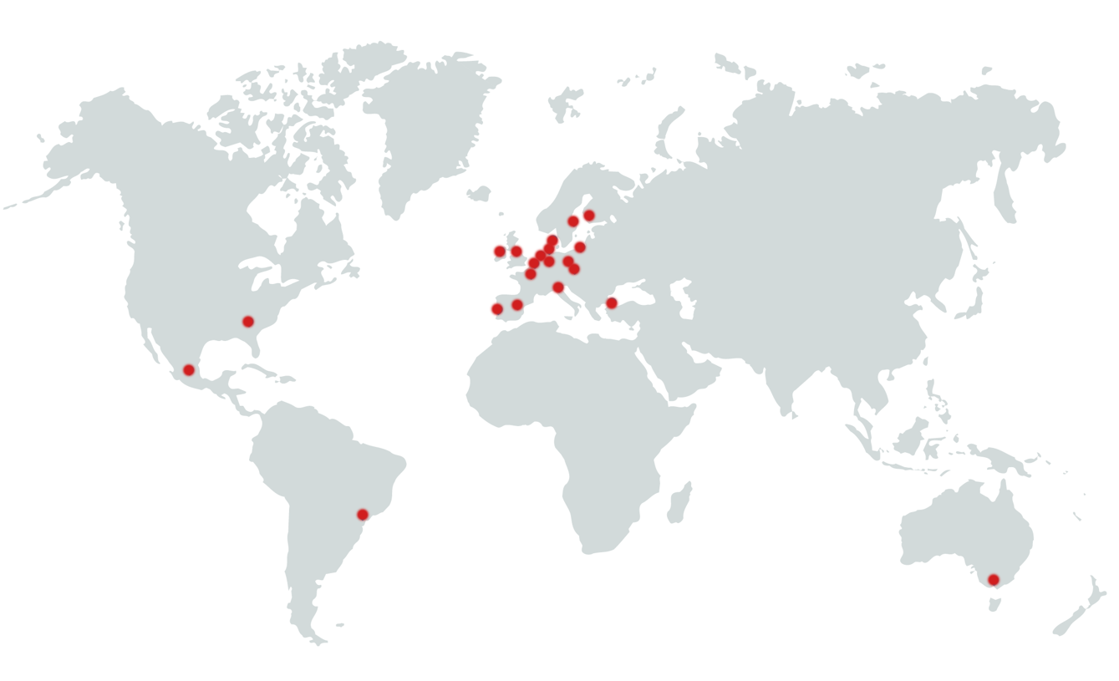
Notes:
Autorola is today present in most of Europe but we are also present in Australia, Mexico and Brasill. The international presence gives us the opportunity to sell cars cross border according to where we find the highest demand and thereby the best prices but it also gives us the insight in trends and challenges in many markets.

Slide 5
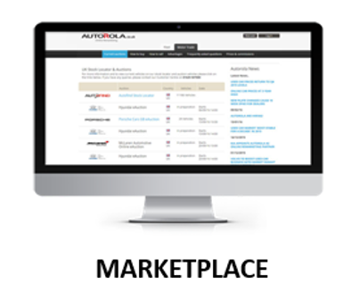
In 2001 Autorola disrupted the Automotive market, by being the first player in Europe with a 100 % online approach to the Auction and Wholesale market.
Morten Holmsten Global Sales Director
Morten Holmsten Global Sales Director
Notes:
I would like to spend all 60 minutes talking about Autorola and our product portfolio, but the reason why I’m standing here is to talk about disruption in the automotive business in Europe.
Back in 2001 Autorola started to disrupt the physical Auction market, by being the first Auction provider going 100 % online with the Auction process. But already in 1996 Autorola made the first attempt. And attempt that failed due to technology not being ready. To slow internet connections and to few lines in and out from the dealerships made an unlike auction impossible.

Slide 6
Did we succeed ?
Morten Holmsten Global Sales Director
Morten Holmsten Global Sales Director
Notes:
Did we then succeed in 2001? This is a question I often ask myself. And the answer is both yes and no.

Slide 7
Today most physical Auctions in Europe have either created an online channel or closed their business.
Morten Holmsten Global Sales Director
Morten Holmsten Global Sales Director
Notes:
If we should be able to say that we succeeded with a disruption, there shouldn’t be any physical Auctions left in Europe. But there is. But we managed to get a fair marketshare and we started the movement towards onlike auctions. So why is it so difficult to make disruption in the Automotive business when it’s seen in so many other business’?

Slide 8
Apple disrupted the mobile market by creating mobiles whitout physical bottoms, which allowed much higher flexibility in the use of the mobile.
Airbnb disrupted the way to rent an apartment as competition to hotels.
Morten Holmsten Global Sales Director
Uber disrupted the way to get from A to B as an alternative to having your own vehicle or driving a Taxi.
Notes:
We all know these three companies today and how they changed the business they are operating in. Apple who removed all physical bottoms from the mobilephone and starting the revolution for the mobilephone from being something you talked in to something which most people today mainly uses for searching on the internet to writing messages. Some of the existing players in the market managed to jump on this journey where others simply dissapeared. Airbnb and Uber also challenged the established players in there markets. Most of them survived but all needed to look into ways to protect there market.

Slide 9
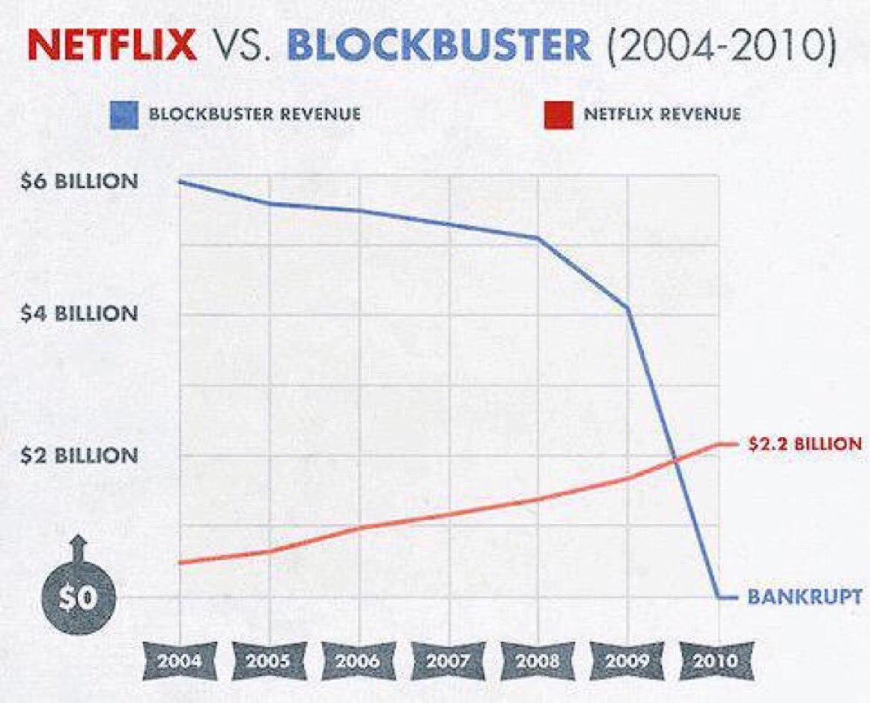
The biggest disruption happened when Netflix started distribute films and series online in 2007. In few years the online distribution took over the hole industry leaving the old players in bankruptcy.
Morten Holmsten Global Sales Director
Morten Holmsten Global Sales Director
Notes:
The biggest disrupter in newer time is Netflix. They totally changed the way movies is distributed and in that way forced the bankruptcy of Blockbuster, who simply didn’t change there business model. Going from more than 9.000 outlets till today one left. Here the use of new technology was perfect to be used in this productline.

Slide 10
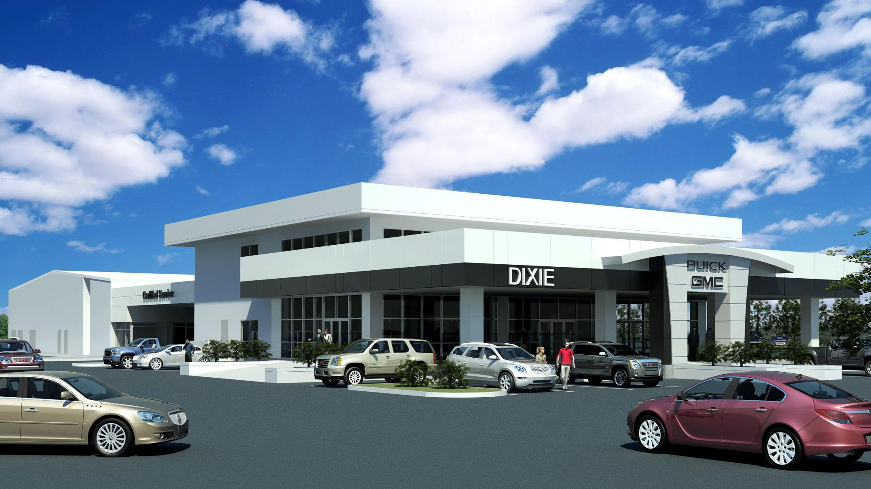
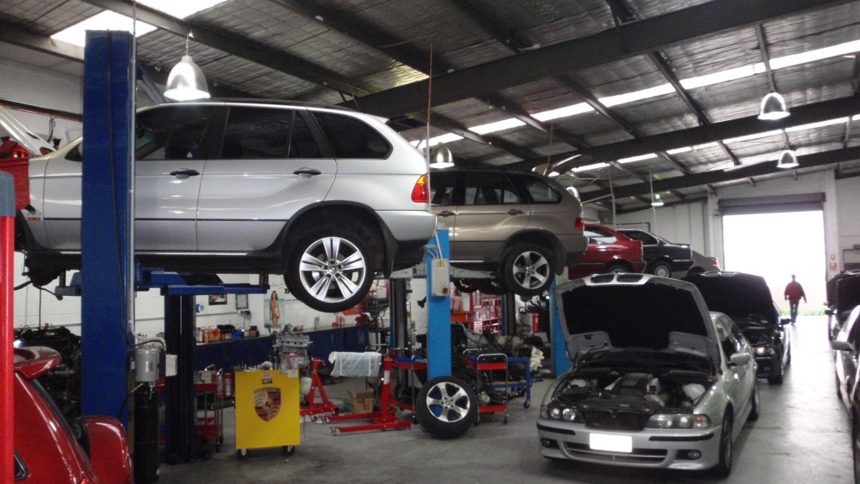
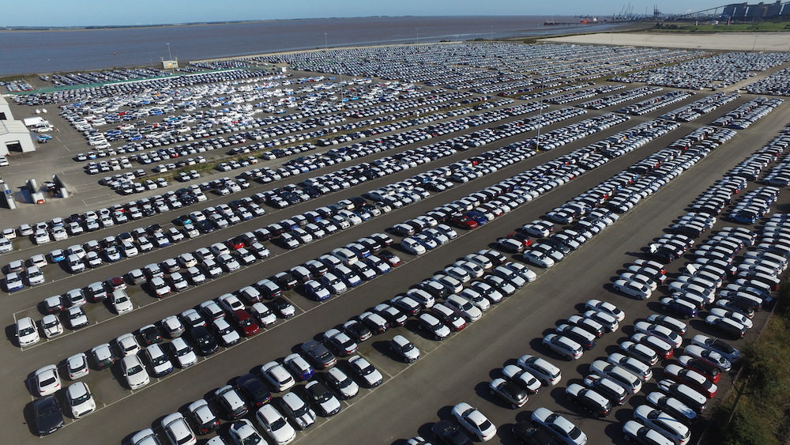
So why is disruption so difficult in the Automotive Industry?
Morten Holmsten Global Sales Director
Morten Holmsten Global Sales Director
Notes:
I believe there is many reasons why it’s so difficult to create real disruption in the automotive industry. First of all we have some very big players who own the products but also most of the distribution channels. They have made big investments in these distribution channels, which means that they do not want to stop using them.
Secondly the product we talks about needs regular physical service. This means that locations is needed for this purpose.
Secondly we are talking about a physical product, not like movies, which are quite expensive to send from a to b.

Slide 11
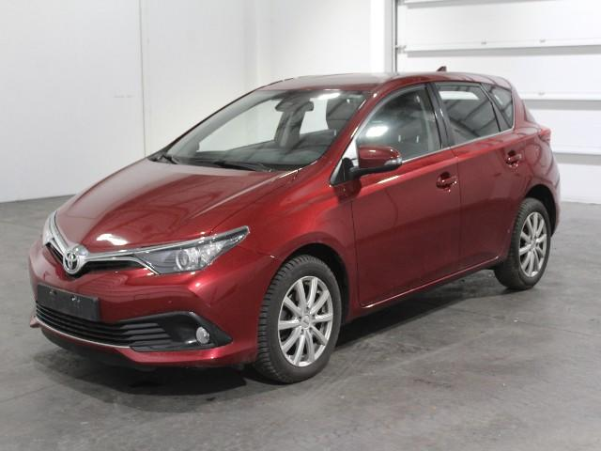
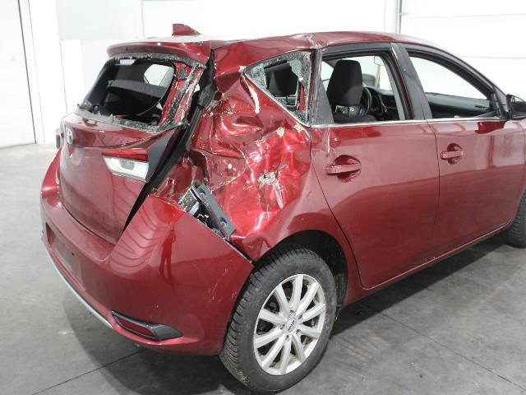
So why is disruption so difficult in the Automotive Industry?
Morten Holmsten Global Sales Director
Notes:
I would like to spend all 30 minutes talking about Autorola and our product portfolio, but the reason why I’m standing here is to talk about disruption in the automotive business in Europe.
Back in 2001 Autorola tried to disrupt the market, by being the first Auction provider going 100 % online with the Auction process.

Slide 12
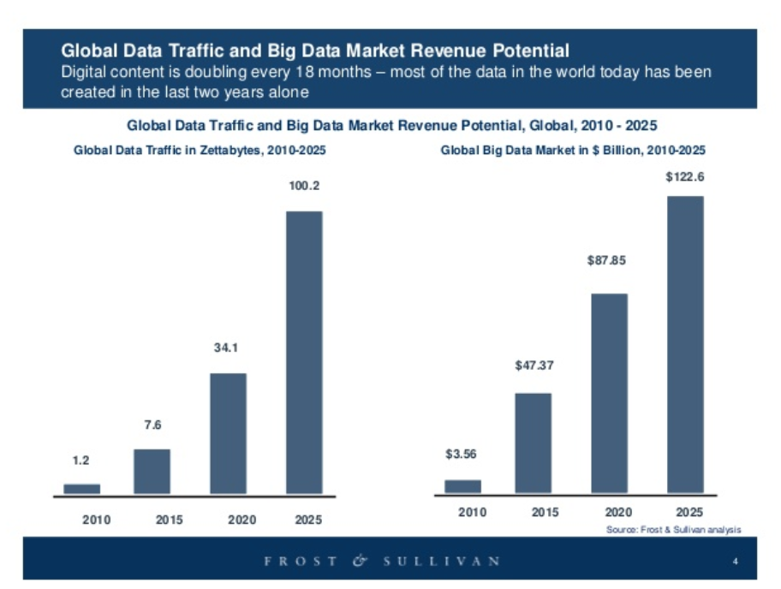
The three major trends in European Automotive Industri
Data driven management
Morten Holmsten Global Sales Director
Morten Holmsten Global Sales Director
Selling online to consumers
Upstream Selling
Notes:
As I said, I’m in charge of one of Autorola’s 3 business units. The 3 business units are Solutions, where we primarily works with customized workflow systems to support everything from Intake of vehicles to the total remarketing process. All of this can be managed and measured towards agreed KPI’s.
Indicata is our market intelligence tool, which based on realtime data measures the performance of your inventory towards the total market.
The last of our Business Units is Marketplace, where we arrange online vehicle auctions either national or internationally depending of the market conditions.

Slide 13
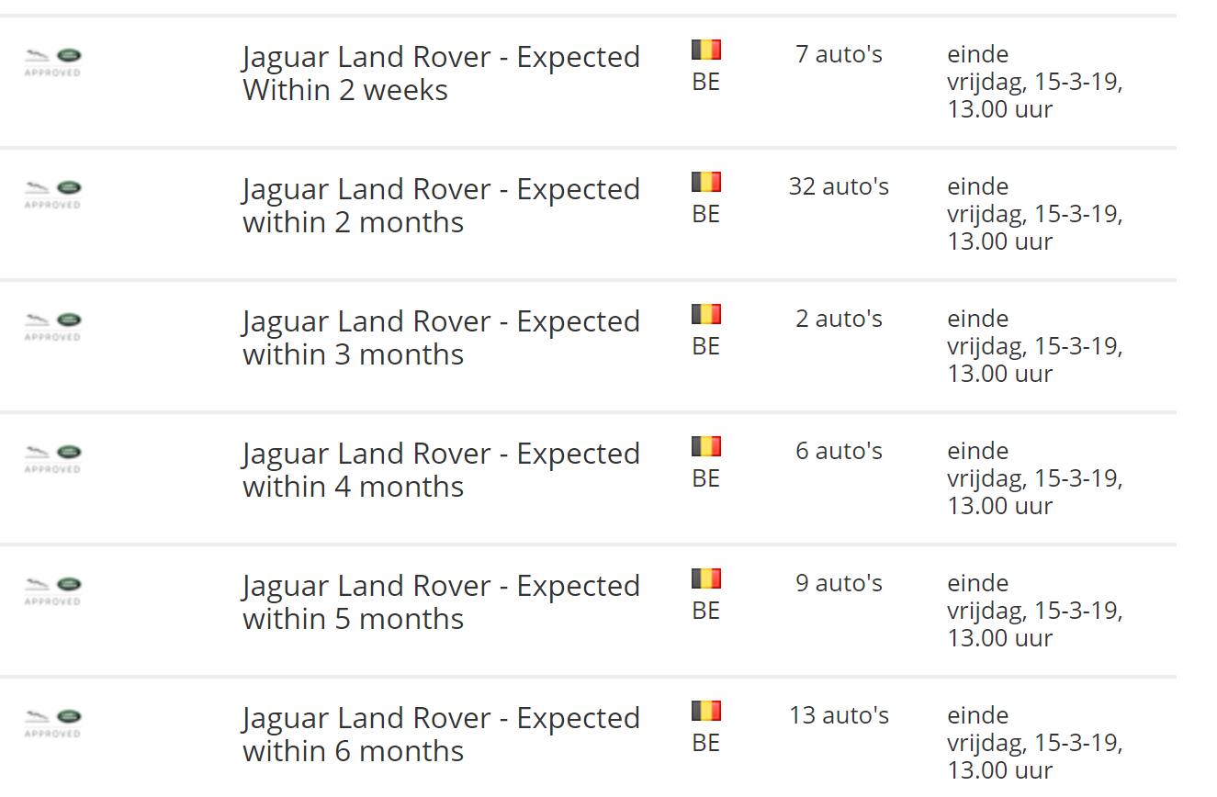
Upstream Selling - OEM
Morten Holmsten Global Sales Director
Morten Holmsten Global Sales Director

Slide 14
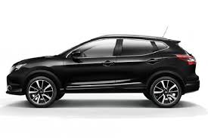
Upstream Selling – Trade In
Morten Holmsten Global Sales Director
Morten Holmsten Global Sales Director

Slide 15
Data driven management
Morten Holmsten Global Sales Director
Morten Holmsten Global Sales Director

Slide 16
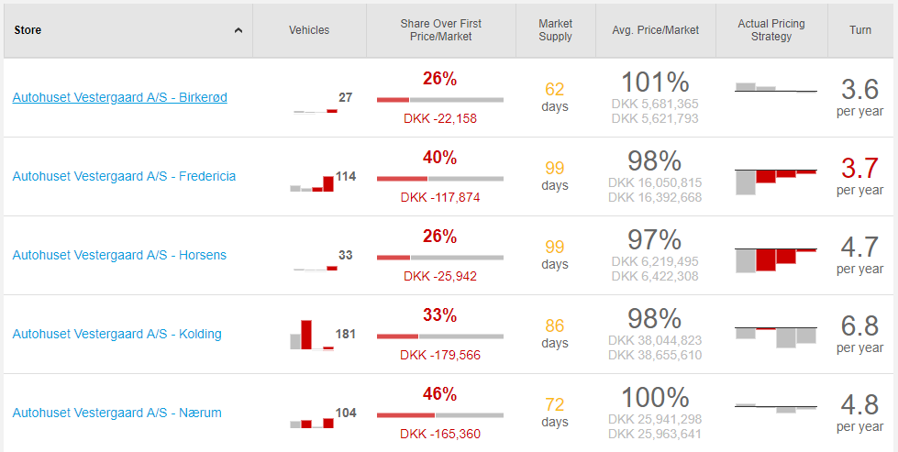
Data driven management
Morten Holmsten Global Sales Director
Morten Holmsten Global Sales Director

Slide 17
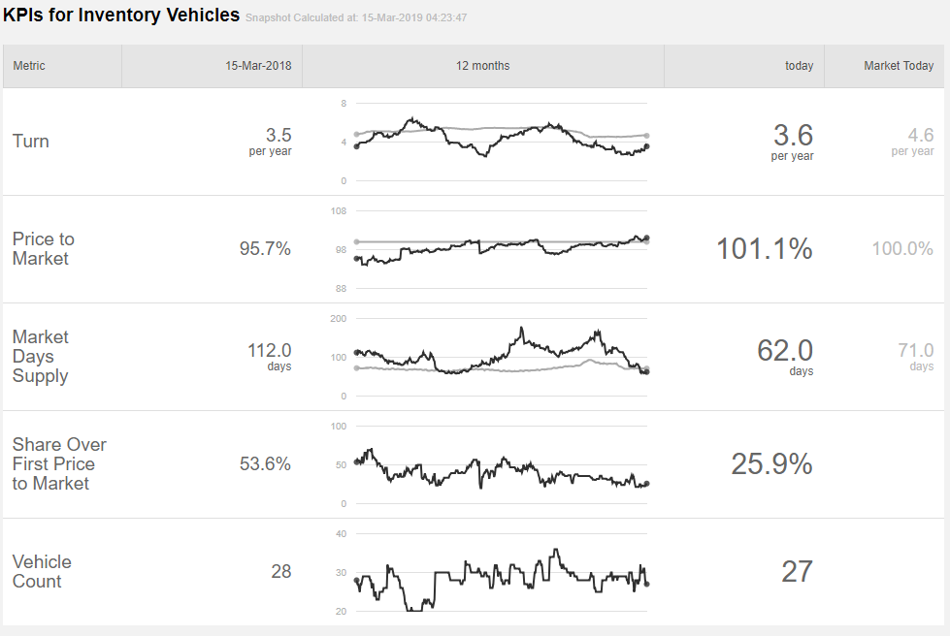
Data driven management
Morten Holmsten Global Sales Director
Morten Holmsten Global Sales Director

Slide 18
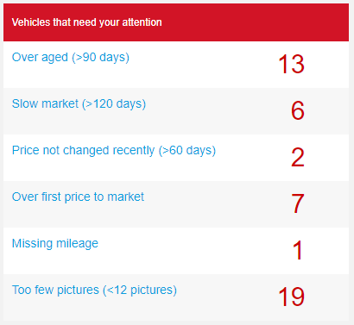
Data driven management
Morten Holmsten Global Sales Director
Morten Holmsten Global Sales Director

Slide 19
Data driven management
Morten Holmsten Global Sales Director
Morten Holmsten Global Sales Director

Slide 20
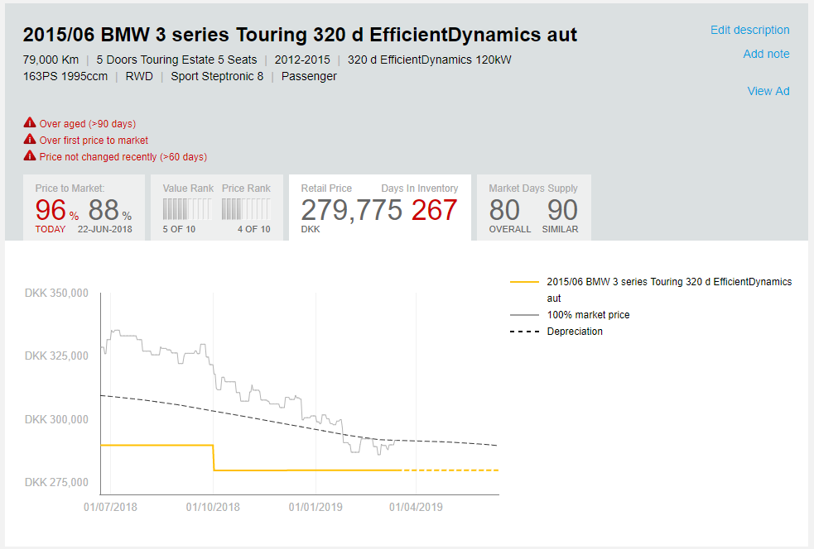
Data driven management
Morten Holmsten Global Sales Director
Morten Holmsten Global Sales Director

Slide 21
Selling online to Consumers
Is it possible to sell a new or used car online to a Consumer?
What challenges do we meet?
What will be the savings?
What do the customers want?
Morten Holmsten Global Sales Director
Morten Holmsten Global Sales Director

Slide 22
Selling online to Consumers

Slide 23
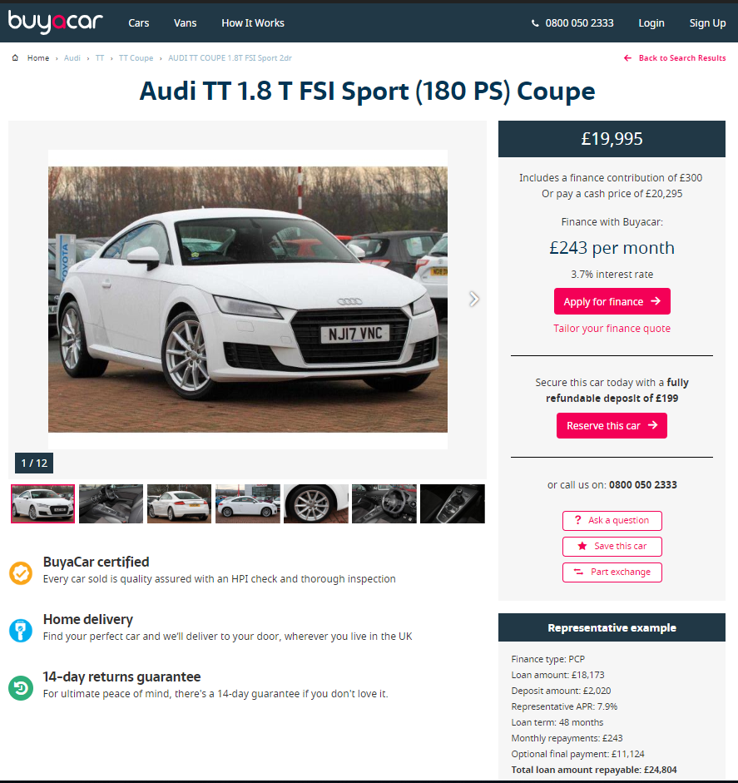
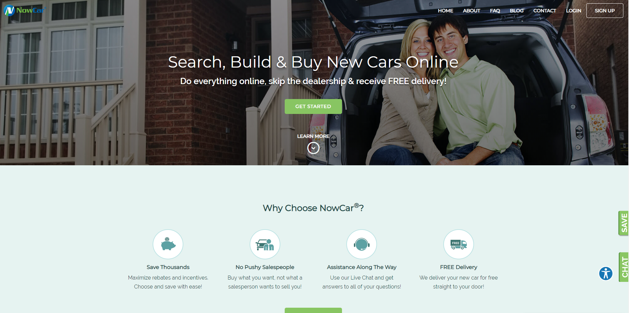
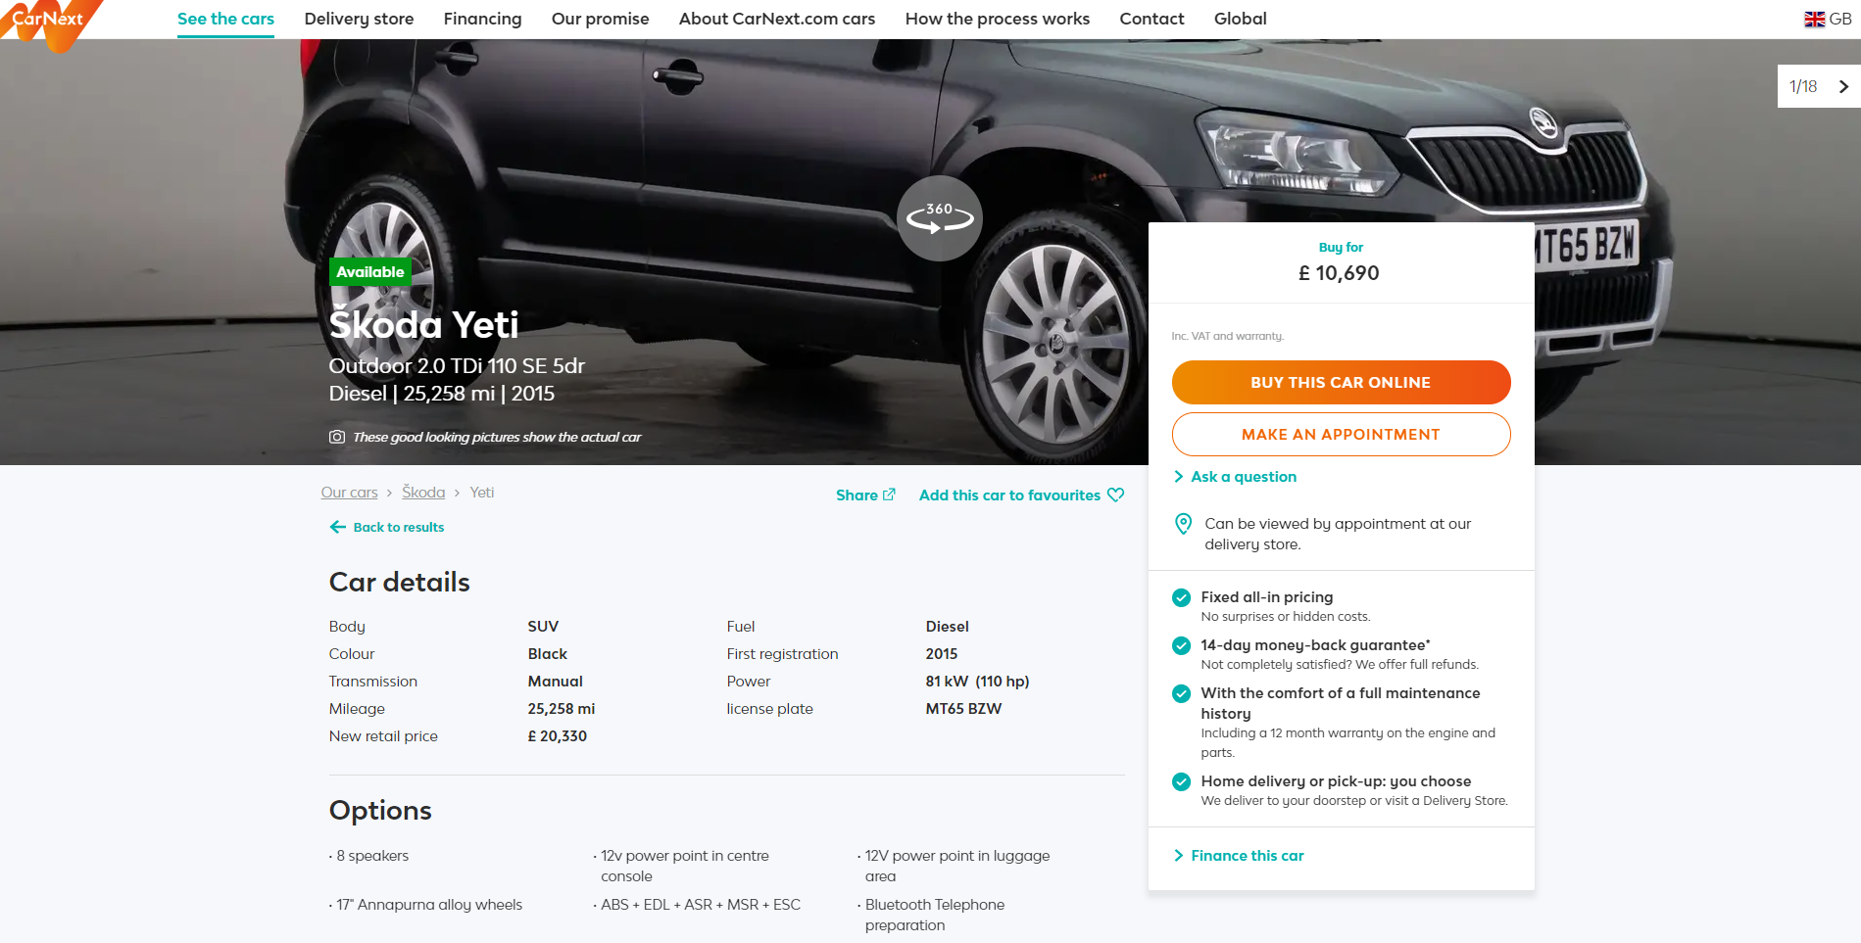

Slide 24
Selling online to Consumers
What about the trade-in car?
Morten Holmsten Global Sales Director
Morten Holmsten Global Sales Director

Slide 25
Selling online to Consumers
Step 1: Create traffic on your web-site
Step 2: Ensure to have nice descriptions
Step 3: Plenty of pictures and video
Step 4: Ensure extra services (transport and return policy)
Step 5: Consider if it’s better to use the online world to generate leads!
Morten Holmsten Global Sales Director
Morten Holmsten Global Sales Director

Slide 26
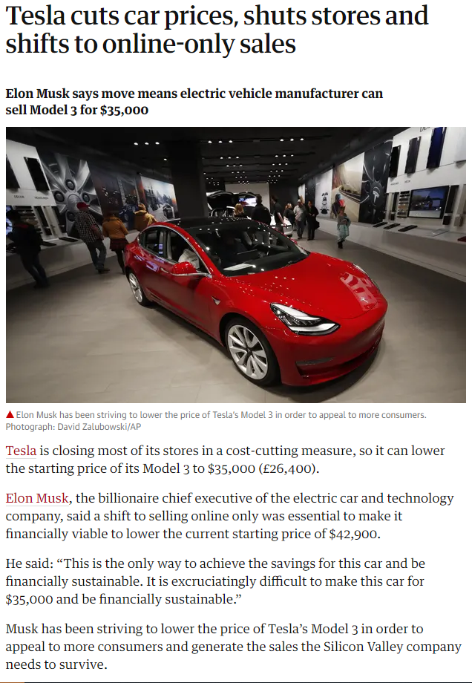
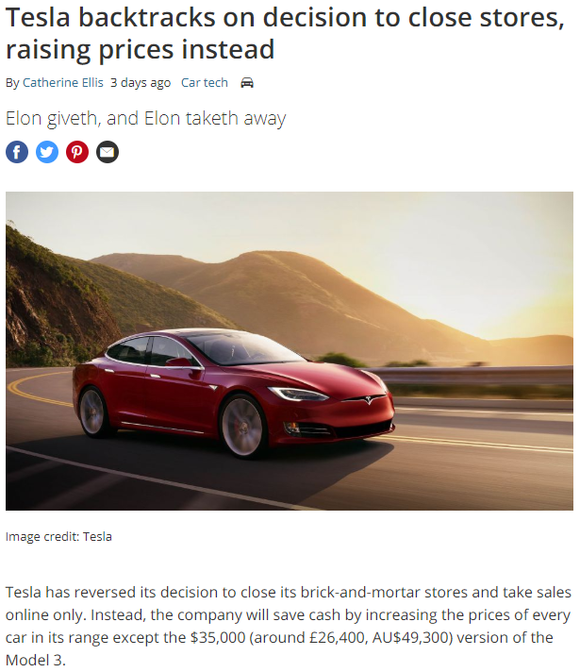
Selling online to Consumers
Morten Holmsten Global Sales Director
Morten Holmsten Global Sales Director

Slide 27
Thank you for your patience
The team of Autorola is here for you:

